Slide 1



Slide 2

Semantic Memory
  Originally thought of as a giant dictionary
  Meanings of words
  Relationships between meanings
  Example: PATROL – GUARD

Slide 3
Associative Memory
  Context relationships between words
  Co-occurrence of words together in language
  Example: ATOM - BOMB

Slide 4

Traditionally considered the same
Or part of the same network system
  Williams’ (1996) Inter-lexical Hypothesis
  Stolz & Besner (1996) modified Interactive Activation Model
May be two separate systems
Notes:
Talking about models of memory

Slide 5
CAT
DOG
CAT
MEOW
FUR
FUR
BARK
MEOW
TAIL
TAIL
BARK
DOG
Spreading Activation
Inter-Lexical Hypothesis

Slide 6
Semantic Features
Words/Lexical Level
Letters
Interactive Activation Model

Slide 7
MEOW
FUR
TAIL
BARK
DOG
CAT
Modified Interactive Activation Model
Notes:
So how do we know what those links are ? Which ones are strongest even connected

Slide 8
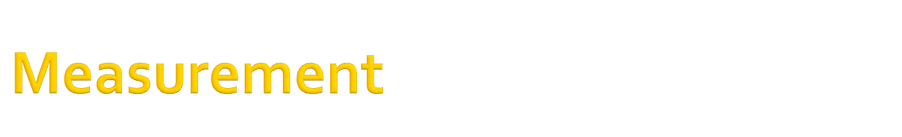
Databases:
  Semantics
    WordNET
    Feature Production Norms
  Associations
    Free Association Norms

Slide 9
Semantics:
  Name all the features of “dogs”
Associations
  What’s the first word you think of when someone says lost?
Notes:
Now that we have these numbers – what can do you with that?

Slide 10
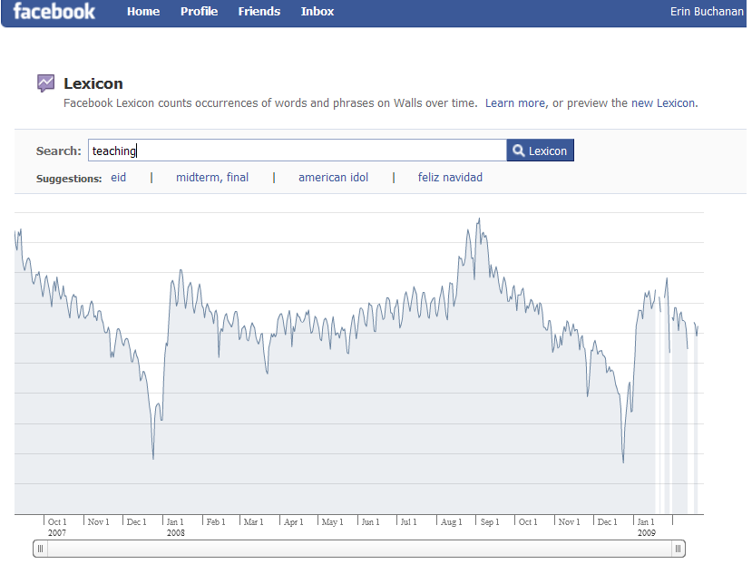

Slide 11

These databases allow researchers to test differences in memory.
  Judgments
  Priming

Slide 12

Participants are given word pairs and asked to judge them on:
  Semantic Relatedness: How many features do these words share?
  Associative Relationship: How many of a 100 college students would give the second word to the first word?

Slide 13

Semantic Example:
  POLE – ROD
  PROOF – CHECK
Associative Example:
  LATHER – SOAP
  CRUST – PIE

Slide 14
Semantic Example:
  POLE – ROD = 10
  PROOF – CHECK = 90
Associative Example:
  LATHER – SOAP = 67
  CRUST – PIE = 46

Slide 15
Research in judgments supports the separation of associative and semantic memory
  Associative judgments
    Predicted by associative relationships only.
  Semantic judgments
    Predicted by both associative and semantic relationships.

Slide 16

Priming research supports the separation and early selection of associative memory.
  The “associative boost”
  Separate priming for both word relationships
  Semantic blocking tasks show associative priming, but can eliminate semantic priming.

Slide 17

Both of these tasks show a support for associative memory stored at a lexical level, separate from a semantic level.

Slide 18

Given associations at a lexical level:
  Reaction times for associative judgments should be faster than semantic judgments
Given that associations and semantics are stored in different links:
  Predictions of reaction times should possibly mirror judgments (and be separate)
Notes:
Due to type of judgment comparison and due to first lexical level

Slide 19

Participants:
  43 subjects; 7 eliminated
Materials:
  138 word pairs
    2 blocks of 15 practice
    2 blocks of 54 experimental
  Mixed relationships

Slide 20
Procedure:
  Explanation of memory type (associative or semantic)
  15 Practice judgments
  54 Experimental judgments with reaction times measured
  Repeat with other judgment type

Slide 21


Slide 22
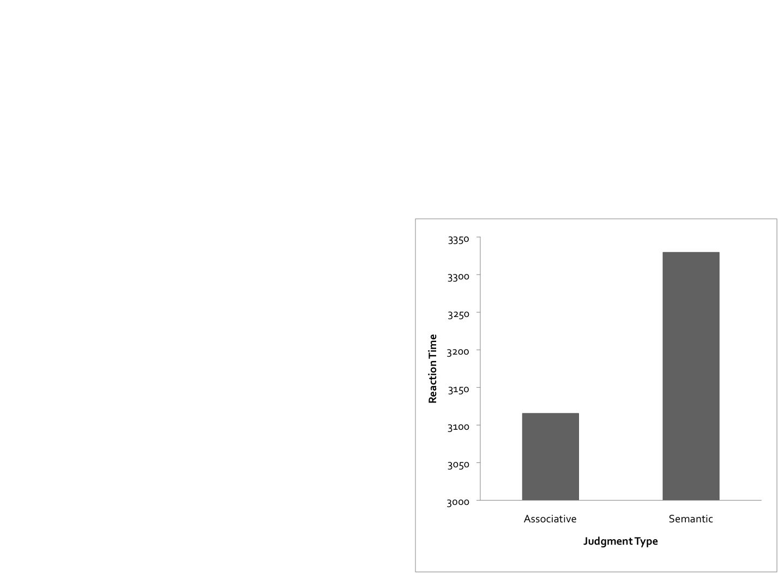
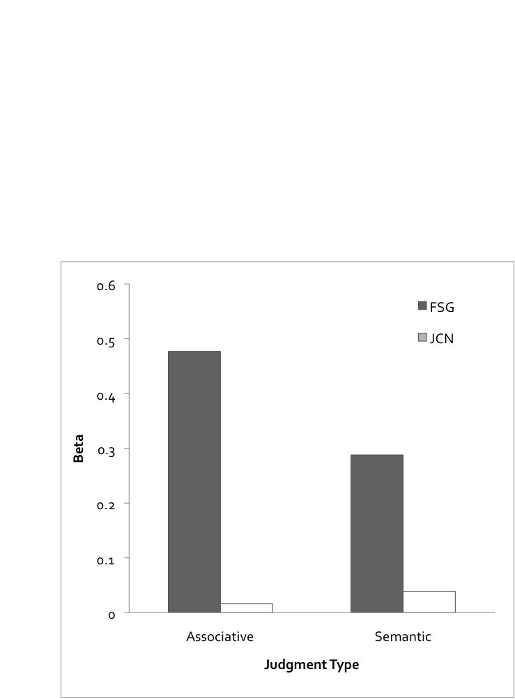

JUDGMENTS
REACTION TIMES
Judgments:

Slide 23
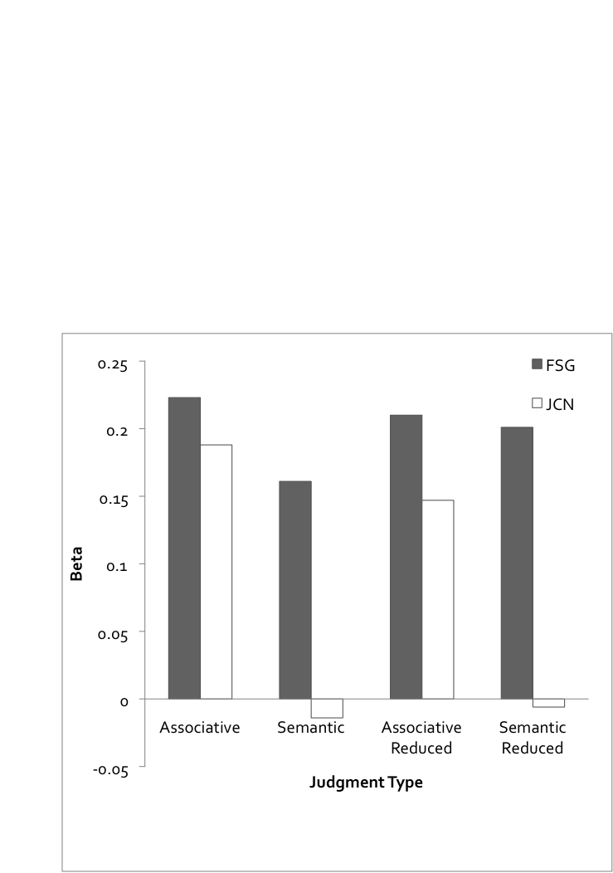
REACTION TIME PREDICTIONS

Slide 24

These findings support the modified Interactive Activation Model
  Associative reaction times were faster
  Associative relationships were predictive of:
    Associative Judgments*
    Semantic and Associative Reactions Times

Slide 25

What’s odd:
  Associative relationships did not predict semantic judgments
  Semantic relationships predicted associative reaction times

Slide 26

Rinse wash repeat.
  36 participants
  Different materials
    15 practice in each condition
    48 experimental in each condition
  Same procedure

Slide 27
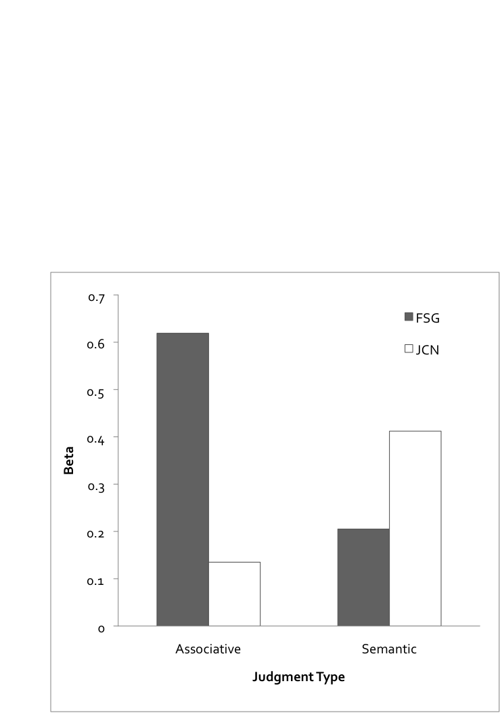

JUDGMENTS
REACTION TIMES

Slide 28
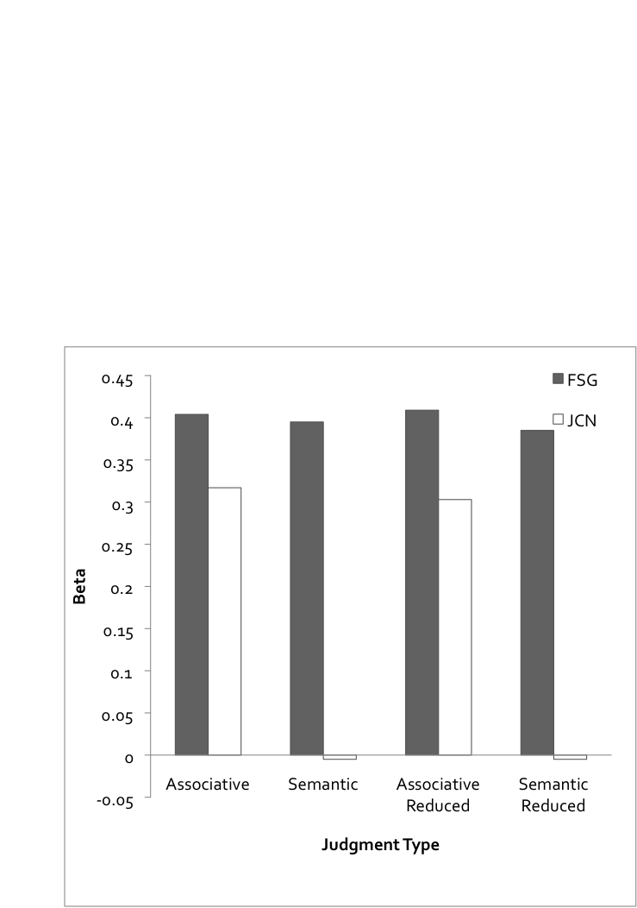
REACTION TIMES

Slide 29
Partially supportive of modified Interactive Activation Model
  Associative relationships predicted:
    All reaction times for judgments
    All judgments

Slide 30

Given:
  Lexical decision time involves activation at the word (assumed association) level
  Associative information predicts judgment reaction time
Prediction:
  Associative information will predict simple lexical decision reaction times

Slide 31
Predictors:
  Association variables
  Semantic variables
  Frequency variables
Predicting:
  Lexical Decision Time
  Naming Reaction Time

Slide 32
LDT
NAMING
Association variables:
  R² = .191
Semantic variables:
  R² = .018
Frequency variables:
  R² = .160
Association variables:
  R² = .119
Semantic variables:
  R² = .007
Frequency variables:
  R² = .120

Slide 33

Overall, there was support for separating associations and semantics in some way:
  By processing level -> due to an associative advantage
  OR
  By linking mechanism -> due to activation/suppression with task demands

Slide 34

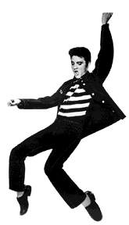
Therefore, we can’t “block” the rock n’ roll – associative information appears to have priority/access during experimental tasks.

